Slide 1
Azure Responsible AI (RAI) dashboard Ruth Yakubu (Cloud Advocate)

Slide 2
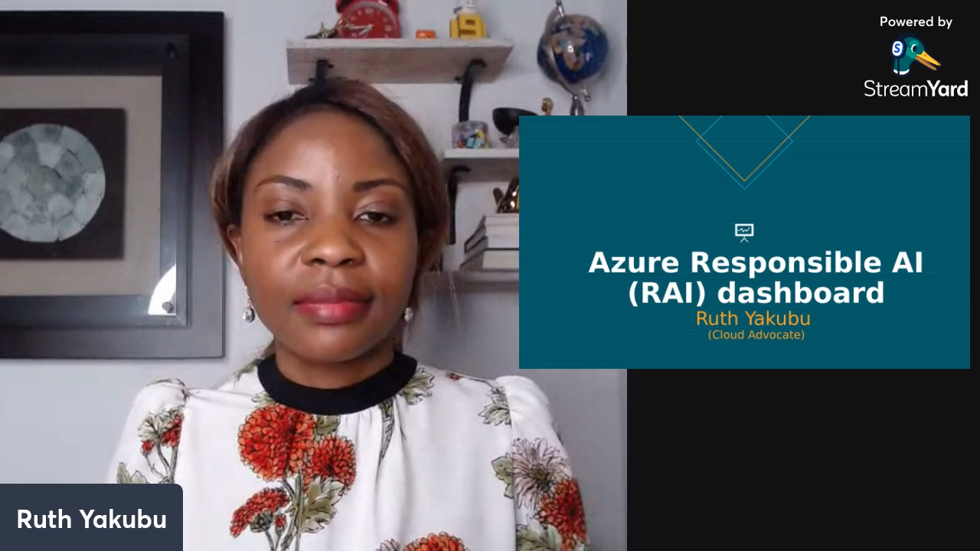

Slide 3
Error Analysis

Slide 4
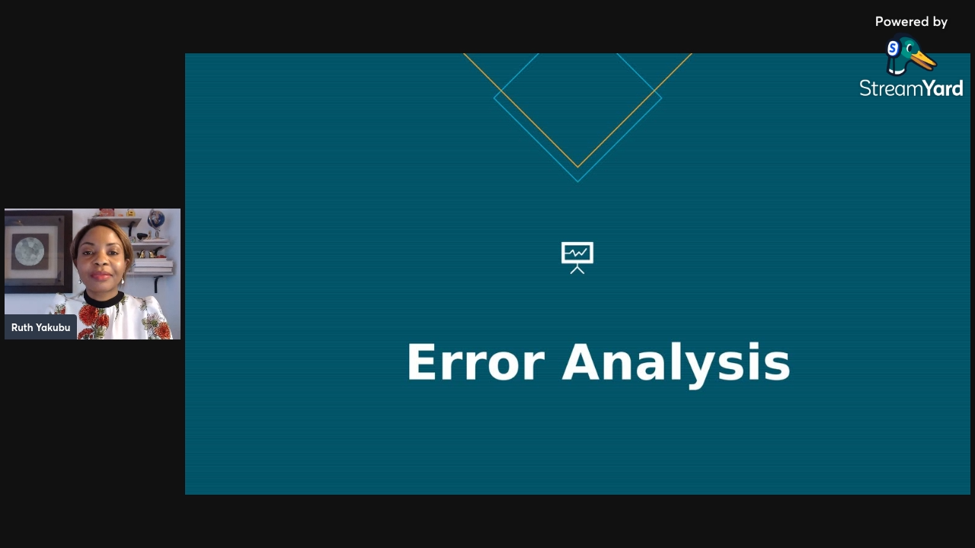

Slide 5
Model Overview

Slide 6
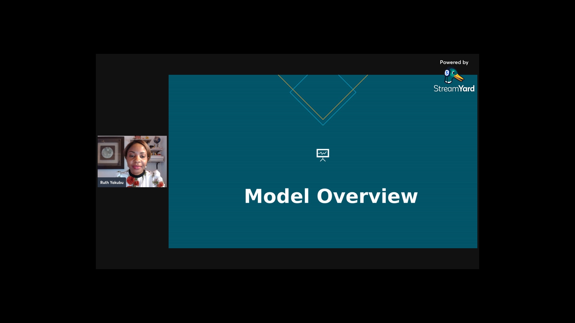

Slide 7
Data Analysis

Slide 8
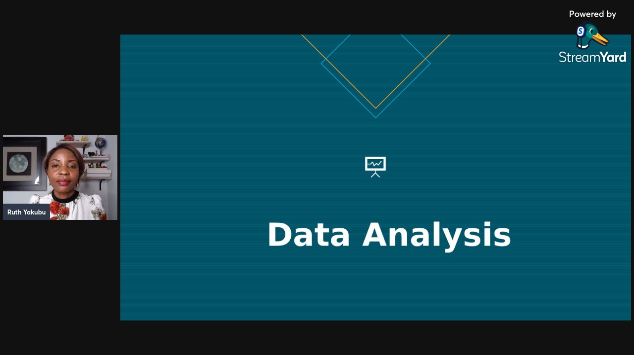

Slide 9
Feature Importance

Slide 10
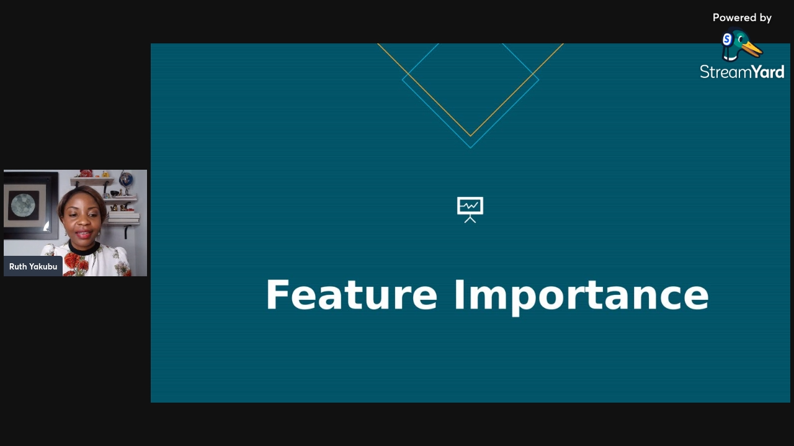

Slide 11
Thank You

